Slide 1

Team
BIT TRACERS

Slide 2
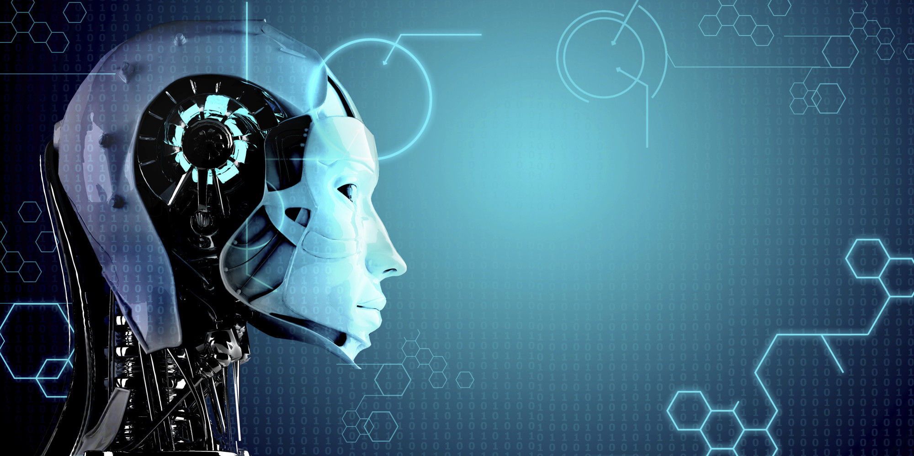
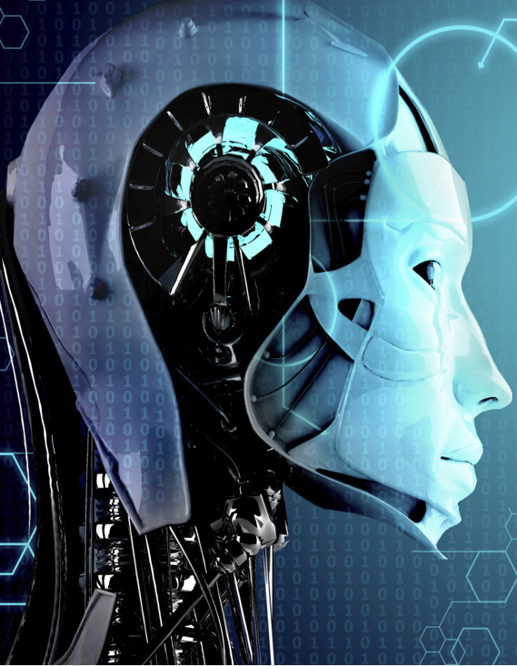
How
Artificial Intelligence Will MakeTechnology
Disappear

Slide 3

Phantom Vibration
9 out of 10 people experience “phantom vibrations”, which is when you think your phone vibrated in your pocket, whereas in fact it didn’t.

Slide 4
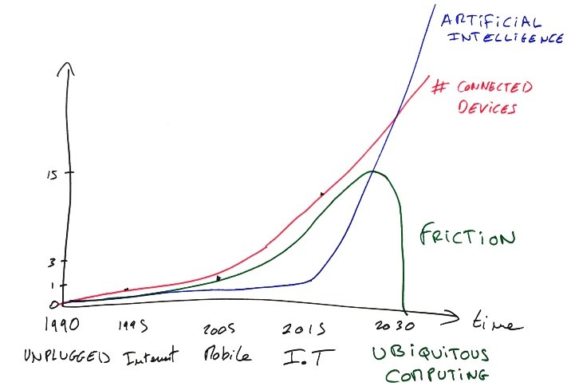
The Digital Revolution
New Era :
O

Slide 5
Historic Example : Electricity
Back In The 1800s
Tangible
Expensive
Current Scenario
Cheaper
More Reliable
Hard to Produce
Dangerous
Safer
Ubiquitous

Slide 6
Context-Awareness
Building this ubiquitous computing future relies on giving devices the ability to sense and react to the current context, which is called “context-awareness”.
A good way to think about it is through the combination of 4 layers :
Device Layer
Individual Layer
Social Layer
Environmental Layer

Slide 7
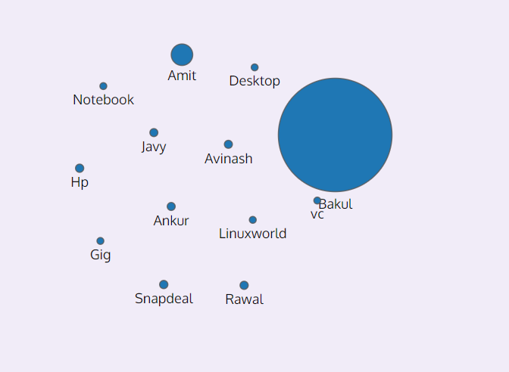
For example, to model the social layer, we can look at the emails that were sent and received by someone, which gives us an indication of social connection strength between a group of people

Slide 8
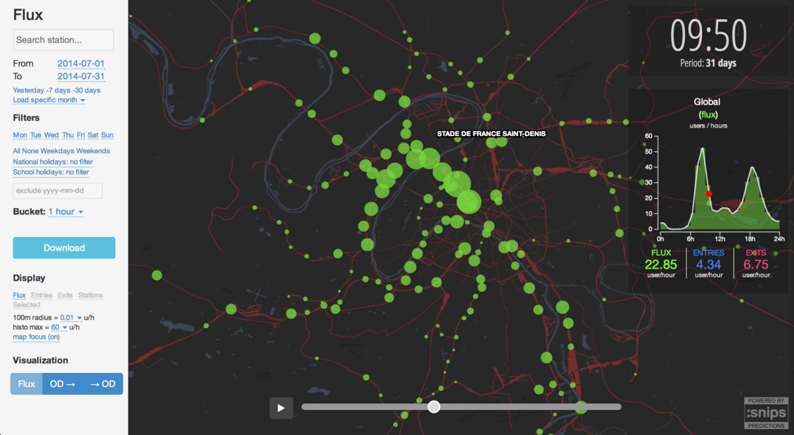

Slide 9

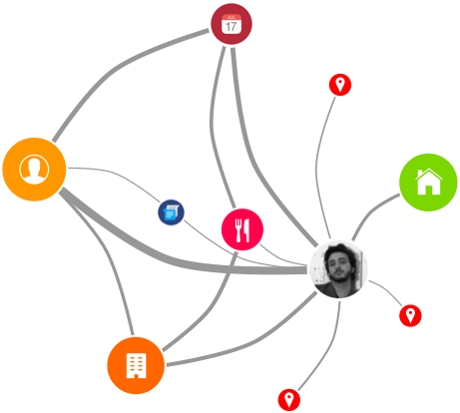
Interpretation of A.I

Slide 10
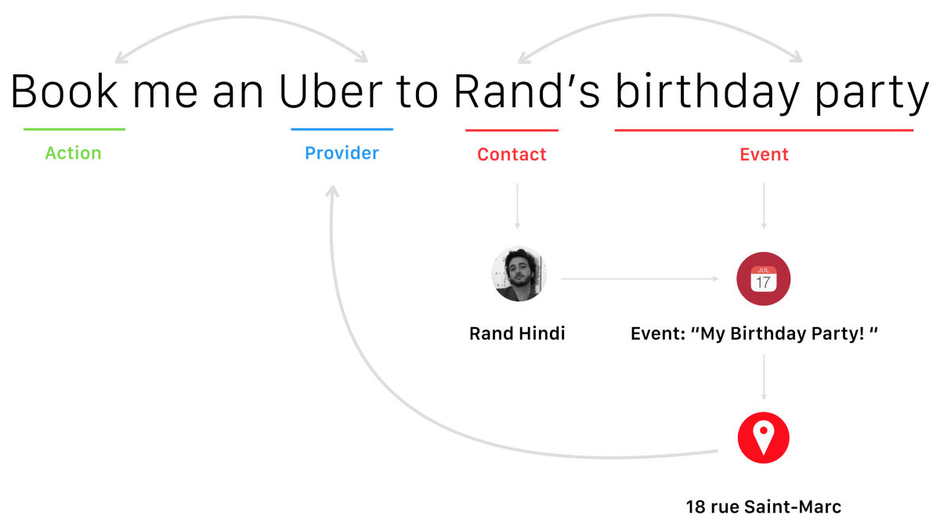

Slide 11
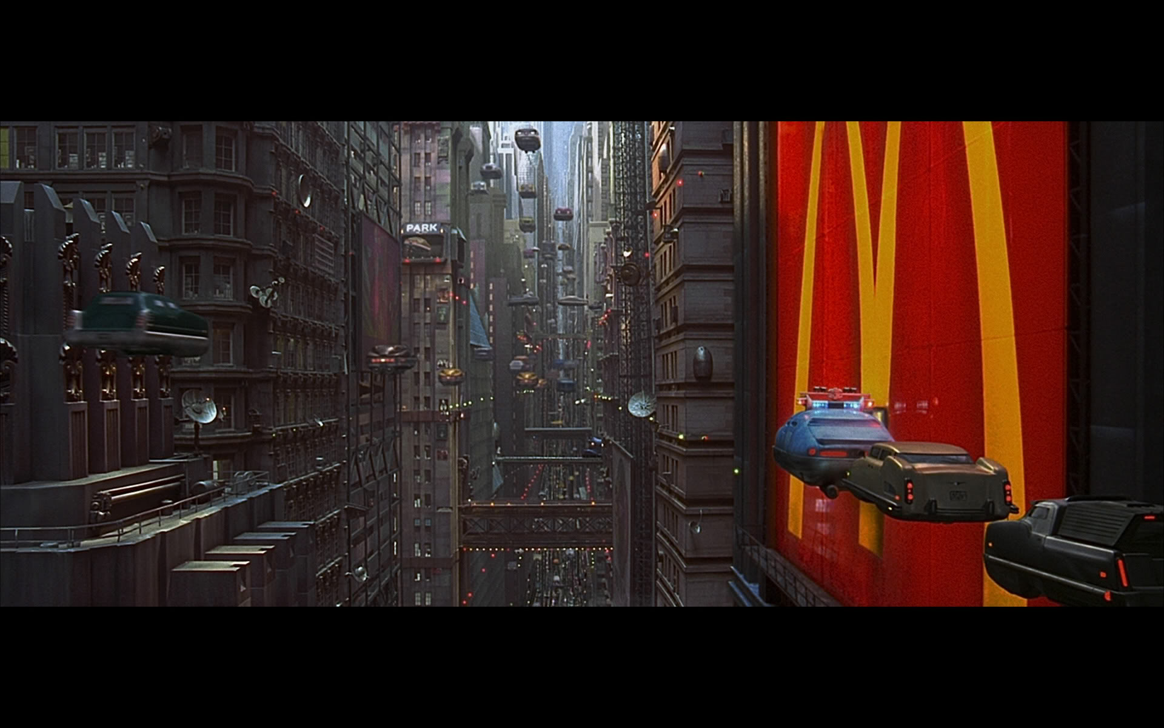
What they wants Future to look alike ..

Slide 12

People wants to feel disconnected without losing the value of technology.

Slide 13
Conclusion
Artificial Intelligence ?
AI is about reproducing Human behavior in a Machine.
People want to feel peace and disconnected.
Its all about making technology disappear and again we will be in UNPLUGGED Era.

Slide 14
References
1. www.google.com
2. www.wikipedia.com
3.www.medium.com/RandHindi
4. www.youtube.com
5. www.tedxecolepolytechnique.com

Slide 15



SUPER TEAM MEMEBRS
BIT-TRACERS
Anubhav Srivastava
Sumit Mishra
Manikant Tiwari
He likes to pursue his network science
and manifesting them within context of
the Web.
Beginner in AI Technologies.
HE sees himself as a knowledge nomad,
and likes to spend his time connecting his
Learning with others.
His work focuses on improving the understanding
of systems using and developing concepts of
Complexity evolution and Ubiquitous computing.
CSE
CSE
CSE

Slide 16
Thank You….

